Slide 1
MSE – 803 – Data Analytics
Week 11 – Activity 2
Wellbeing Time Series
Andre Benedetti
28/06/2026

Slide 2
Wellbeing - Dataset
This data set contains wellbeing data from three Years: 2014, 2016, and 2018.
Out of the 30 Variable wellbeing mesures presented, the Overall life satisfaction was selected for this analysis.
Its data was classified under 12 Demographics groups: Sex, Age group, Ethnicity, Famility type, Highest qualification, Household income, Housing tenure, Labour force status, Life stage, Migrant status, Personal Income, and Region. Additionally there is a Total population group.
The collected data regarding the Overall life satisfaction was classified based on a scale from 0 to 10, Where 0 means completely dissastified and 10 completed satisfied.
There was no missing value or outliners.

Slide 3
Wellbeing - Forecast
As the dataset contains data from only 3 Years, applying Linear Regression, XGBoost, LSTM, ANN, and ARIMA may introduces severe structural and mathematical invalidations.
Linear regression: While simple, fitting a linear trend line across just 3 temporal points yields only 1 degree of freedom (N - 2 parameters). Any isolated shock, macro-economic event, or minor outlier in just one of those years will heavily skew the slope coefficient. It forces a linear constraint onto structural changes that are inherently non-linear, resulting in extreme instability and virtually no predictive reliability.
ARIMA: Mathematically, ARIMA requires a minimum baseline of 30 to 50 continuous data points (T > 29) to accurately compute autocorrelation
LSTM: For an LSTM to map a sequence, it needs thousands of continuous steps to adjust its internal gates (forget, input, and output gates). Feeding a 3-year timeline into an LSTM is structurally meaningless, as there is zero "long-term memory" to capture, leading to catastrophic overfitting or an inability to converge during backpropagation.
ANN: Multi-Layer Perceptrons or standard feed-forward ANNs possess thousands of trainable weights and biases. To optimize these parameters without overfitting, the volume of data points must significantly exceed the number of network connections. With only 3 data steps, an ANN will simply memorize the noise in the dataset, achieving perfect training accuracy but failing completely to generalize to any external data.
XGBoost: With only 3 temporal steps, the algorithm has no variance to split on.

Slide 4
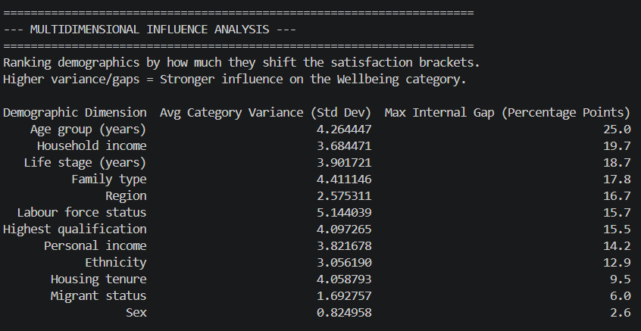
Wellbeing - Multidimensional Influence
The multidimensional influence analysis reveals that generational and structural socioeconomic factors are the primary drivers of disparities in population wellbeing. Age group leads the impact with the largest internal chasm (a maximum gap of 25.0 percentage points), followed closely by household income (19.7) and life stage (18.7). Conversely, core biological and identity factors show the least practical influence on happiness variance, with sex recording a negligible maximum gap of just 2.6 points.

Slide 5
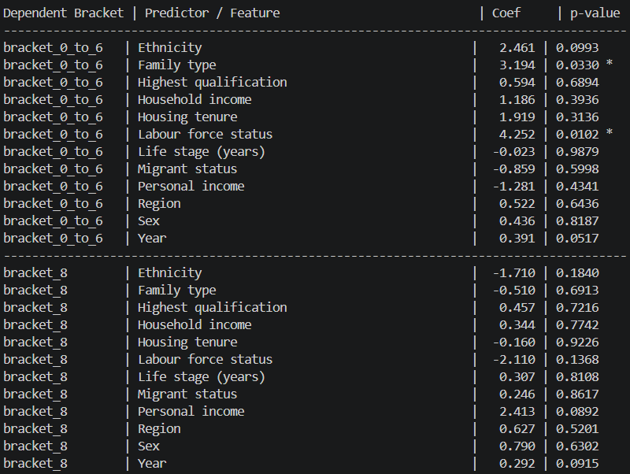
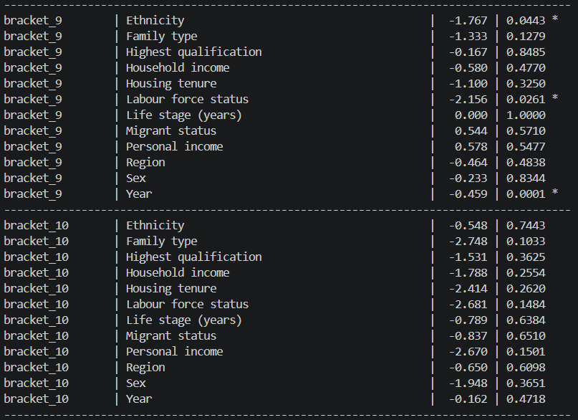
Wellbeing – Multivariance Multiple Regression
The multivariate regression analysis isolates key statistically significant (p < 0.05) structural drivers of societal wellbeing, using Bracket '7' as the omitted reference category to prevent perfect collinearity, as all subcategory percentages must mathematically sum to 100%. The model reveals that Labour force status is a critical predictor across the spectrum, significantly expanding the low-satisfaction proportion (scores 0–6) by 4.25 percentage points (p = 0.0102) and draining high-satisfaction (score 9) by 2.16 points (p = 0.0261). While Family type significantly aggravates vulnerability in the 0–6 bracket (+3.19 points), peak thriving (score 9) is heavily compressed by Ethnicity disparities (-1.77 points) and exhibits a reliable, systemic decline over the Years (-0.46 points per year, p = 0.0001).

